Slide 1
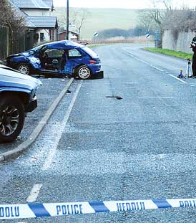
CAR ACCIDENT SEVERITY
Applied Data Science Capstone

Slide 2
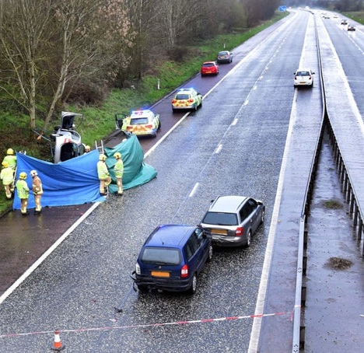
A life cost problem
1.35 million people died per year
Between 20 and 50 million more people suffer non-fatal injuries
3% of gross domestic product is the cost of Road traffic crashes

Slide 3

Anything to do ?
Is there anything we can do?
Is there a way to prevent accidents?
Is it possible to predict the severity of accidents?
Has data science anything to offer?
Can we find some patterns through the data?
What if a model could predict the severity of an accident?

Slide 4
The Data
The data set which will be used is the “Collisions—All Years” provided through the Applied Data Science Capstone by Coursera. They are data from SDOT Traffic Management Division.
The data consists of the information about the accidents. This includes all types of collisions from 2004 to present. The data has 194,673 rows and 38 columns. The columns are referred as the features of the dataset and every row referred in a single collision.

Slide 5
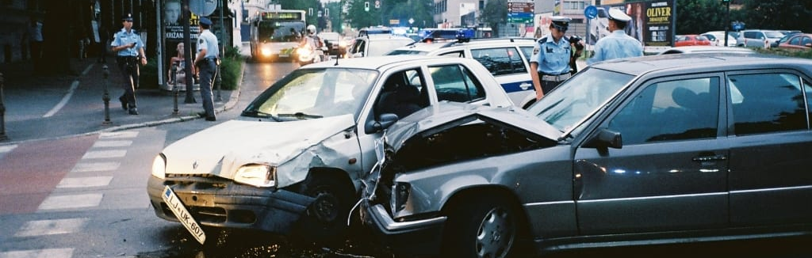
Data analysis

Slide 6
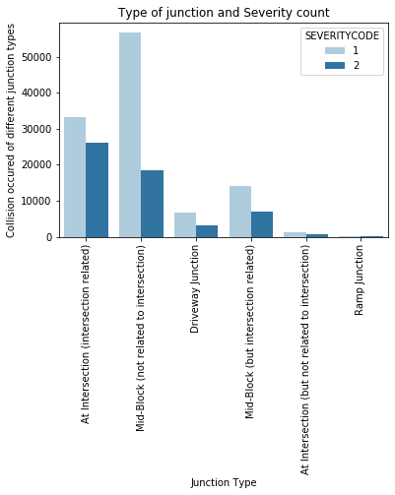
Junction type and Severity
Most Prop Damage accidents take place in Mid-Block (not related to intersection.
Most accidents with injuries take place in At Intersection (intersection related).

Slide 7
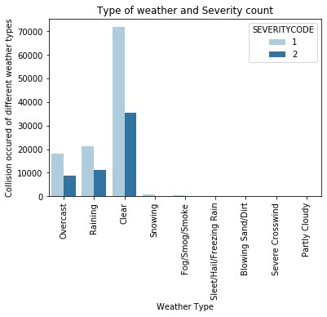
Weather and Severity
Surprising, majority of the accidents with injuries take place in good weather conditions
Raining conditions following in prop damages and people injuries

Slide 8
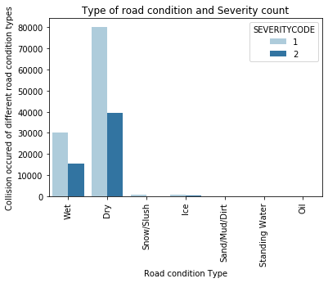
Road condition and Severity
Surprising, most accidents take place in dry road conditions
Although, wet road condition have many prop damages and injuries too.

Slide 9
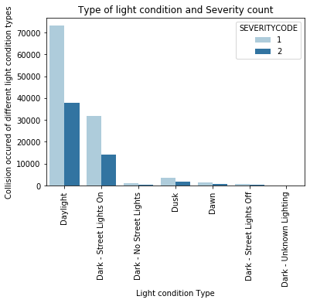
Light condition and Severity
Only few accidents take place in poor visibility conditions.
Most accidents take place in daylight.

Slide 10


Modeling
Selected Methods
Selected evaluation tests
Logistic Regression
Support Vector Machine
Decision Tree
Random Forest Classifier
Accuracy
Recall
F-1 score
Prediction

Slide 11
Results
• There are no significant correlation between the attributes and the severity of collision
• The best method to predict the severity of an accident is probably the Decision Tree method.
MODEL | ACCURACY SCORE | F1 SCORE | PRECISION | RECALL
Logistic Regression | 0.698522 | 0.815985 | 0.694297 | 0.989394
Decision Tree | 0.708404 | 0.812444 | 0.718400 | 0.934818
Random Forest | 0.707956 | 0.812195 | 0.718064 | 0.93473
Support Vector Machine | 0.675593 | 0.806393 | 0.675593 | 1

Slide 12
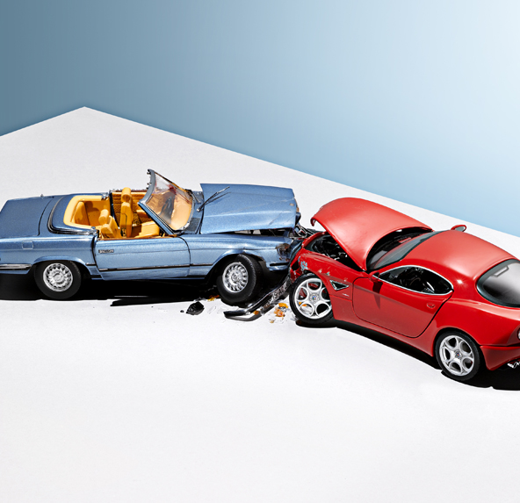
Conclusion
In our minds, there is tight correlation between weather conditions, road conditions, light conditions, junction types and severity of vehicles collisions. In reality there are so many attributes that affect the outcome of a crash so that the contribution of a specific one is too hard to be evaluated.
It remains the human influence the most significant factor for the result of an accident. The level of watchfulness, the driving experience and even the driving habits are difficult to be measured and to be part of a model.

